Slide 1
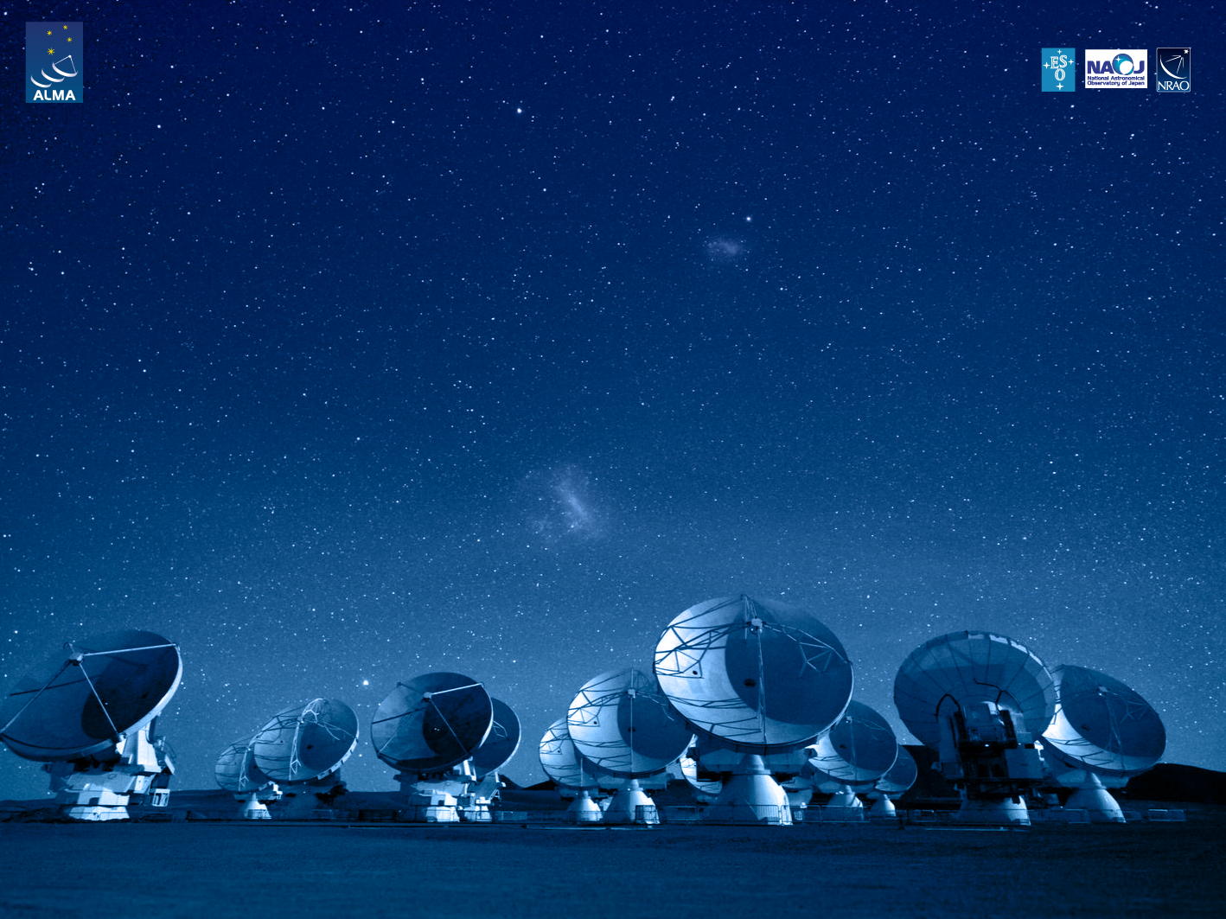
ALMA Common Software Basic Track
Component implementation guidelines

Slide 2
Purpose
Explanation to quickly implement a component in java and C++
Notes:
2

Slide 3
IDL example
HelloDemo stripped example from ACS/LGPL/CommonSoftware/jcontexmpl
IDL HelloDemo.idl
#include <acscomponent.idl>
#pragma prefix "alma"
module demo
{
interface HelloDemo : ACS::ACSComponent
{
string sayHello();
};
};
Notes:
3

Slide 4
Makefile example
Makefile tags:
#common tag for all three programming languages:
IDL_FILES = HelloDemo
# + programming languages specific tags
make all generates stubs and skeletons from HelloDemo.idl:
java: HelloDemo.jar
C++: libHelloDemoStubs.so/a and HelloDemoC/S.h/inl
Python: HelloDemo_idl.py
Notes:
4

Slide 5
Java example Makefile
Java specific makefile tags:
#Java specific makefile tags:
DEBUG = on
COMPONENT_HELPER = On
COMPONENTS_JARFILES = jcontexmplComp
jcontexmplComp_DIRS = alma/demo/HelloDemoImpl
User defined implementation in jcontexmplComp.jar
Notes:
5

Slide 6
Java example: from IDL to implementation
#pragma prefix "alma"
module demo
{
// a very simple component
interface HelloDemo : ACS::ACSComponent {
string sayHello();
make all
alma.demo.HelloDemo.java
alma..demo.HelloDemoHelper.java
alma..demo.HelloDemoHolder.java
alma..demo.HelloDemoOperations.java
....
java.lang.String sayHello();
alma.demo.HelloDemoHelper.java
alma..demo.HelloDemoImpl.java
Notes:
6

Slide 7
Java example: HelloDemoHelper
extends alma.acs.container.ComponentHelper
instantiate the implementation: HelloDemoImpl
A template (*tpl) can be generated by setting the Makefile tag COMPONENT_HELPER = ON
Notes:
7

Slide 8
Java example: HelloDemoImpl
Implementation of the IDL methods:
public class HelloDemoImpl implements
ComponentLifecycle, HelloDemoOperations{
private ContainerServices m_containerServices;
private Logger m_logger;
public void initialize(ContainerServices containerServices) { ... }
public void execute() { ... }
public void cleanUp() { ... }
public void aboutToAbort() { ... }
public String sayHello() {
return "hello";
}
}
Notes:
8

Slide 9
C++ example Makefile
C++ Makefile tags:
# … in addition to common tags …
# C++ specific makefile tags for the implementation
# C++ component “lives” as a shared library:
LIBRARIES = HelloDemoImpl
# compiling the implementation …
HelloDemoImpl_OBJECTS = HelloDemoImpl
# … and linking against generated stubs library:
HelloDemoImpl_LIBS = HelloDemoStubs
component user’s implementation in: libHelloDemoImpl.so/a
Notes:
9

Slide 10
C++ example: from IDL to implementation
module demo
{
// a very simple component
interface HelloDemo : ACS::ACSComponent {
string sayHello();
make all
Genereted from IDL
HelloDemoS.h:
namespace POA_demo { ..
class HelloDemo {
…
char *sayHello();
….
Base class for the implementation
HelloDemo.h
HelloDemoImpl.cpp
To be implemented by user
Notes:
10

Slide 11
C++ example: HelloDemoImpl
Implementation of the IDL method:
HelloDemoImpl.h:
#ifndef _HELLO_DEMO_H_
#define _HELLO_DEMO_H_
#include “acscomponentImpl.h”
#include “HelloDemoS.h”
class HelloDemoImpl :
public acscomponent::ACSComponentImpl, public POA_demo::HelloDemo {
public:
HelloDemoImpl(const ACE_CString &name, maci::ContainerSrvices *cs);
~HelloDemoImpl();
// lifecycle methods
char* sayHello(); // implementation of IDL method
}
#endif
HelloDemoImpl.cpp:
#include “HelloDemoImpl.h”
HelloDemoImpl::HelloDemoImpl(const ACE_CString &name, maci::ContainerSrvices *cs) : ACSComponentImpl(name, cs) {…}
char *HelloDemoImpl::sayHello(){ std::cout << “Hello World” << std::endl;
return “HelloWorld”; }
#include <maciACSComponentDefines.h>
MACI_DLL_SUPPORT_FUNCTIONS(HelloDemoImpl)
Notes:
11

Slide 12
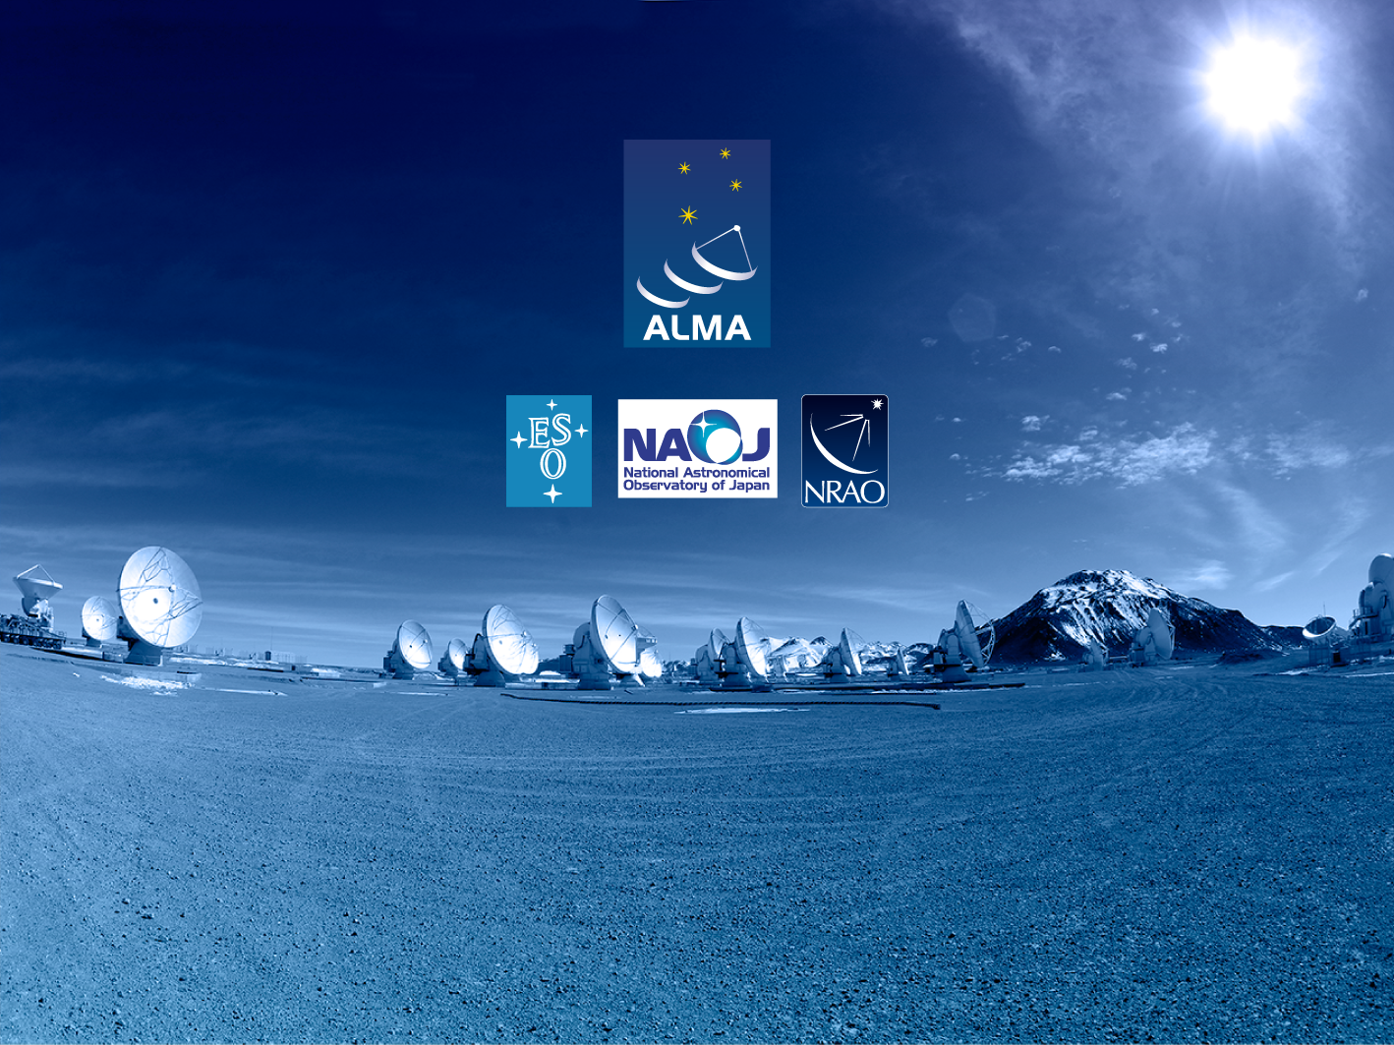
Questions?
Acknowledgements
ACS presentations were originally developed by the ALMA Common Software development team and has been used in many instances of training courses since 2004. Main contributors are (listed in alphabetical order): Jorge Avarias, Alessandro Caproni, Gianluca Chiozzi, Jorge Ibsen, Thomas Jürgens, Matias Mora, Joseph Schwarz, Heiko Sommer.
The Atacama Large Millimeter/submillimeter Array (ALMA), an international astronomy facility, is a partnership of Europe, North America and East Asia in cooperation with the Republic of Chile. ALMA is funded in Europe by the European Organization for Astronomical Research in the Southern Hemisphere (ESO), in North America by the U.S. National Science Foundation (NSF) in cooperation with the National Research Council of Canada (NRC) and the National Science Council of Taiwan (NSC) and in East Asia by the National Institutes of Natural Sciences (NINS) of Japan in cooperation with the Academia Sinica (AS) in Taiwan. ALMA construction and operations are led on behalf of Europe by ESO, on behalf of North America by the National Radio Astronomy Observatory (NRAO), which is managed by Associated Universities, Inc. (AUI) and on behalf of East Asia by the National Astronomical Observatory of Japan (NAOJ). The Joint ALMA Observatory (JAO) provides the unified leadership and management of the construction, commissioning and operation of ALMA.

